Slide 1
Internet & WEB

Slide 2
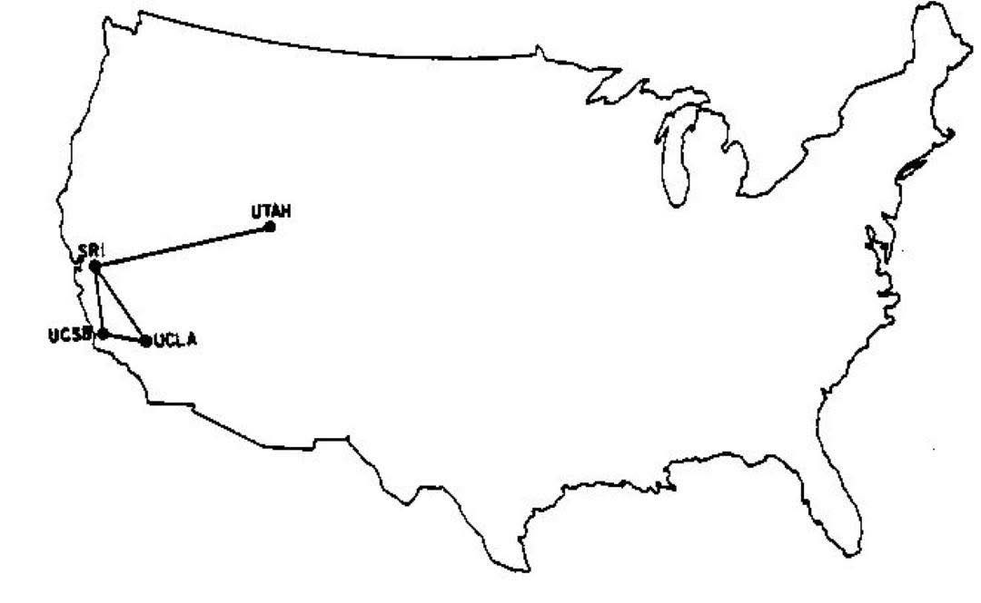
ARPANET - 1969

Slide 3
TCP / IP

Slide 4
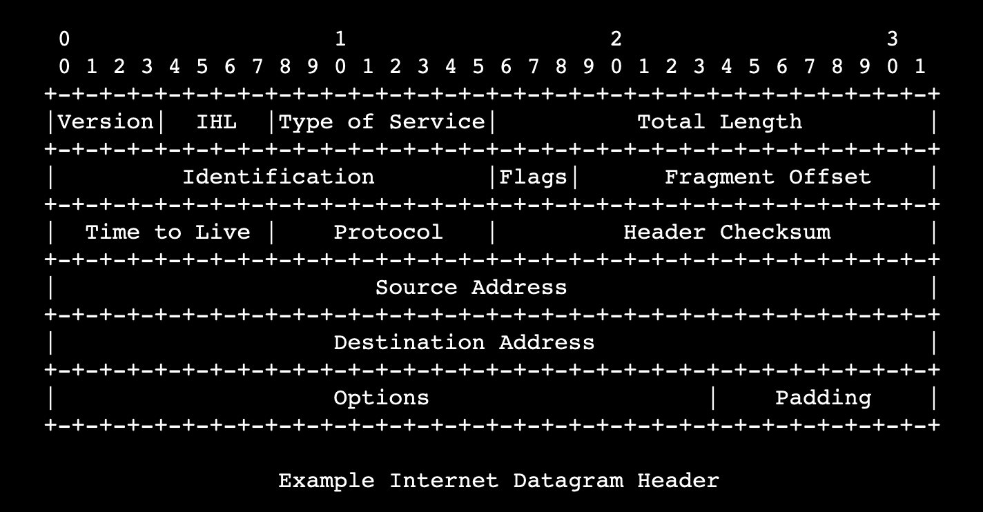
IP: #.#.#.#

Slide 5
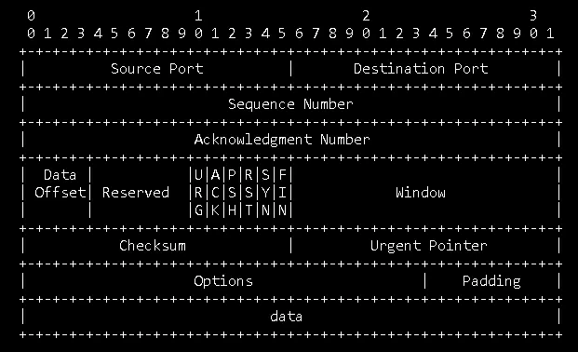
TCP Segment

Slide 6
Data Flow
Application
Application
HTTP, SMTP, FTP, DNS
Transport
Transport
TCP Segmentation
Network
Network
IP Packets
Link
Link
Frames

Slide 7
DNS (Domain Name System)
Domain | IP
example.com google.com facebook.com … | 104.18.27.120 142.250.75.110 157.240.234.35 …

Slide 8
http://www.example.com/

Slide 9
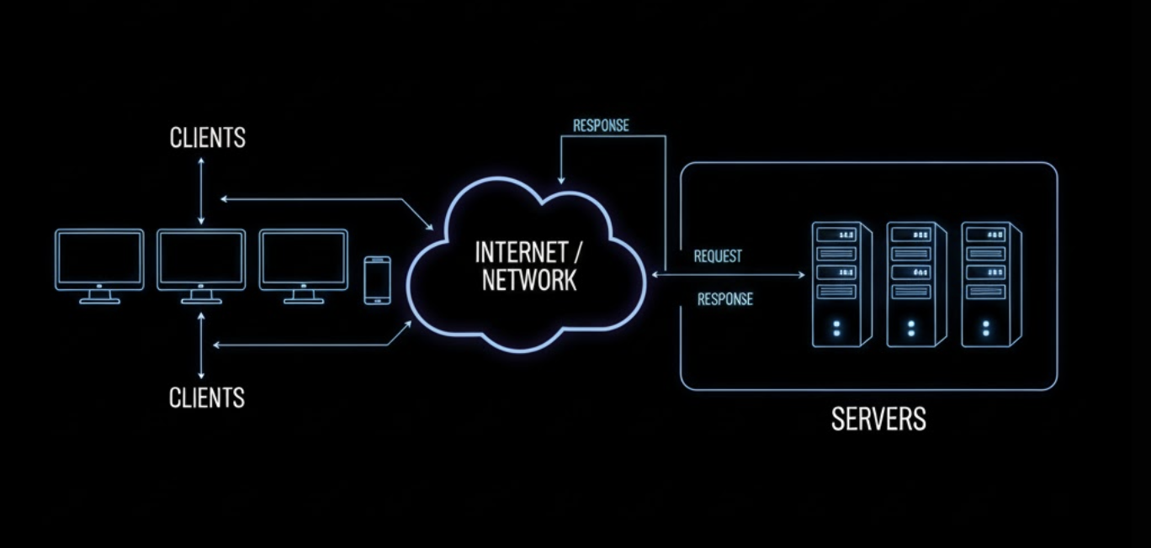

Slide 10
HTTP

Slide 11
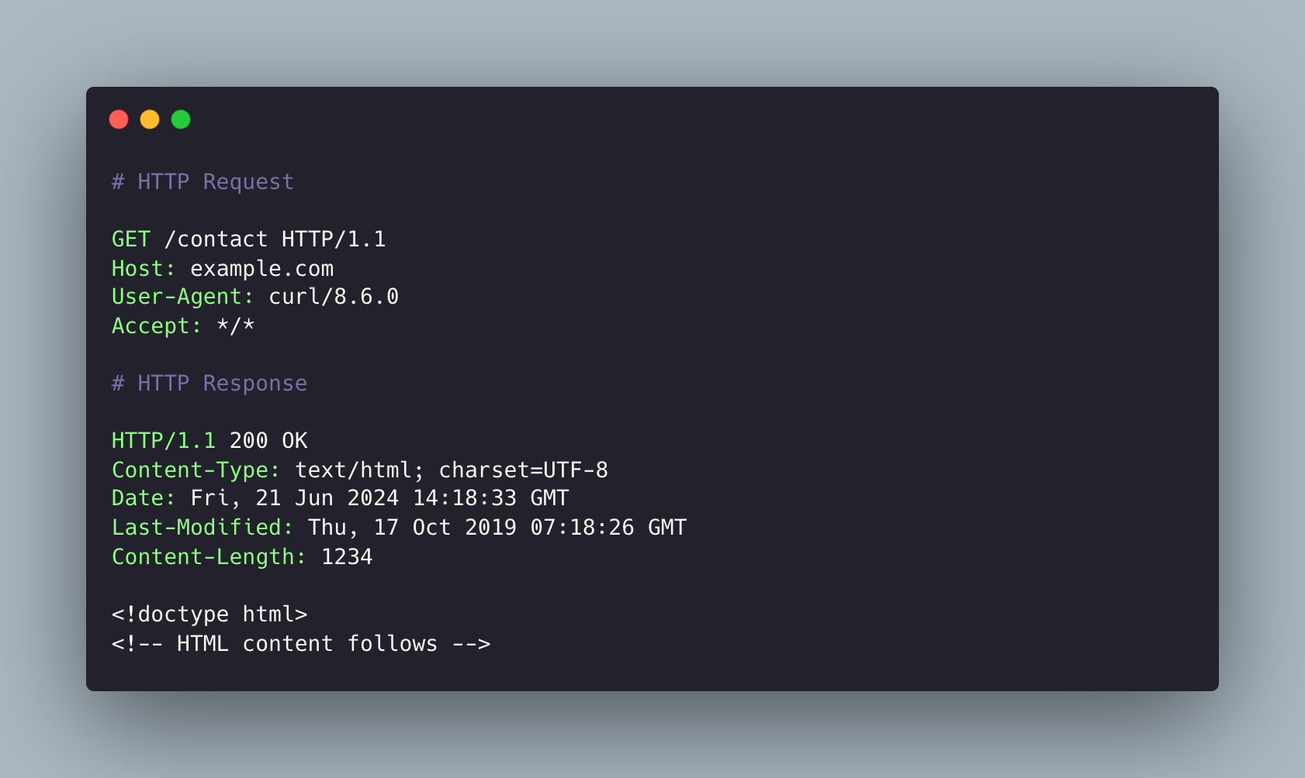

Slide 12
HTTP Request
GET - We are requesting a resource from the server
POST - We are creating a resource on the server
PUT/PATCH - We are updating a resource on the server
DELETE - We are deleting a resource

Slide 13
HTTP Response
2xx - OK
3xx - Redirect
4xx - Client Error
5xx - Server Error

Slide 14
HTTPs

Slide 15
Request-Response Lifecycle
When we type google.com
The DNS Lookup: Finding the Address
The Handshake: Establishing a Connection
The Request: "Can I have the page, please?"
The Response: The Server Answers
Rendering: Building the Visuals

Slide 16
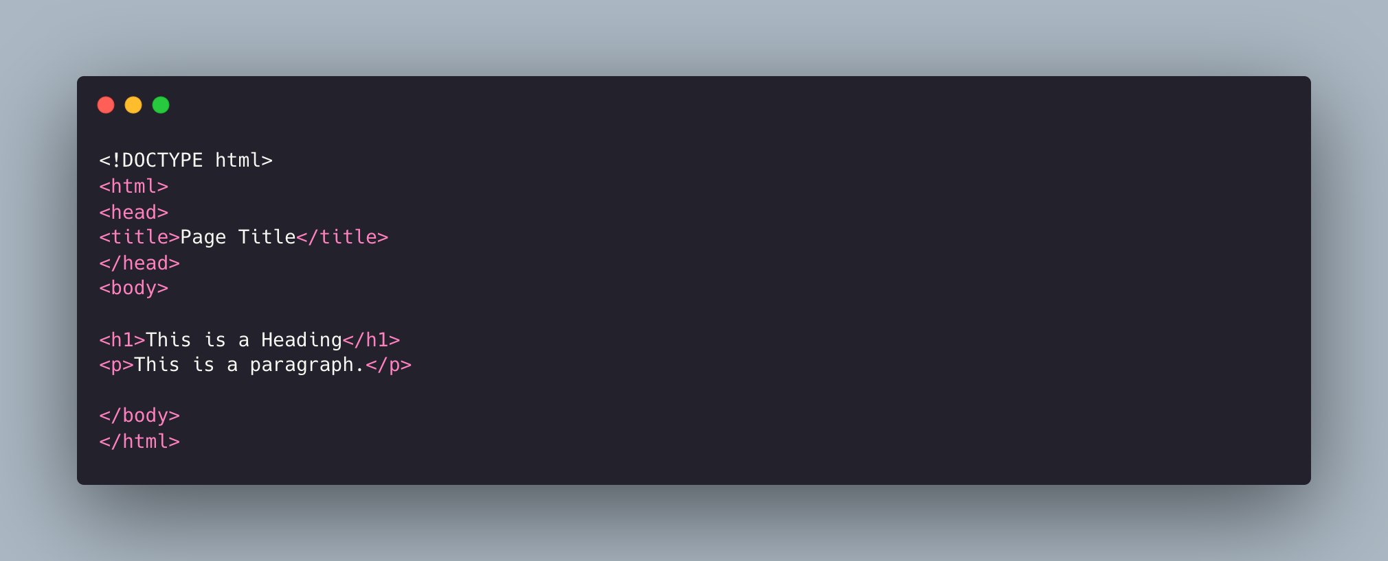
WEB Application Structure

Slide 17
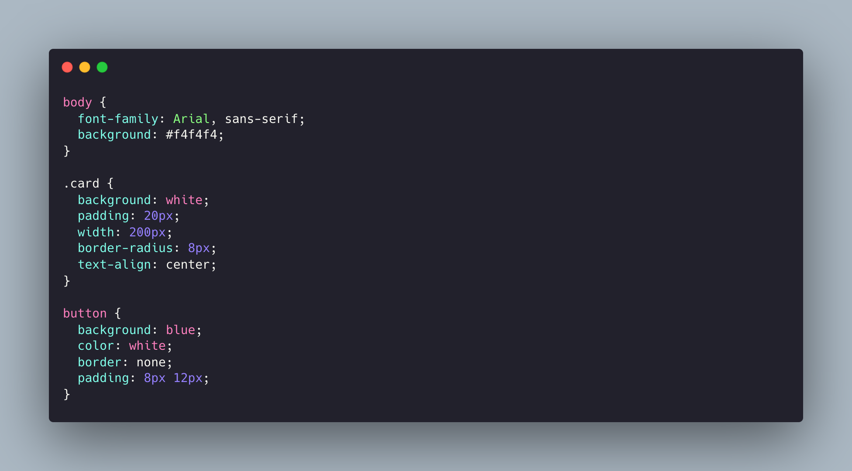
Visual Representation

Slide 18
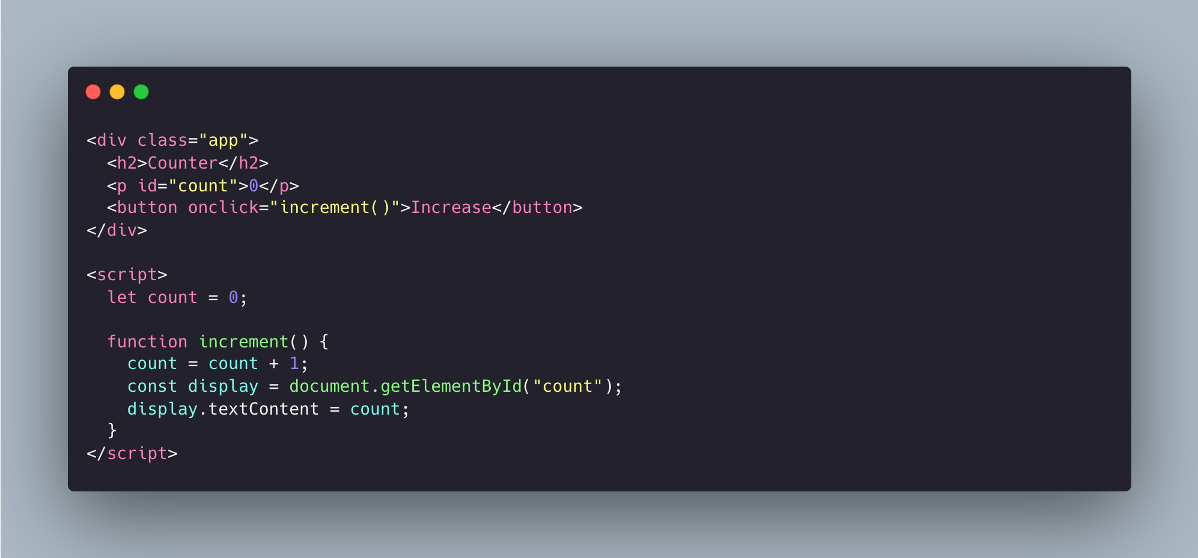
Behaviour

Slide 19
Real-life Examples

